Slide 1

Unsupervised Zero-Shot Reinforcement Learning via Functional Reward Encodings
Kevin Frans, Seohong Park, Pieter Abbeel, Sergey Levine University of California, Berkeley, 2024
Presented by Michael Lugassi

Slide 2

Agenda
Zero-Shot RL Problem
Functional Reward Encoding (FRE)
Experimental Benchmarks
Limitation & Conclusion

Slide 3

Zero-Shot RL Problem
Challenge
How can we train a generalist, multitask agent using offline data such that it can immediately solve new tasks in a zero-shot manner, without any additional training?
Target
Create a model that can understand the essence of a task based on just a few examples of state–reward pairs

Slide 4
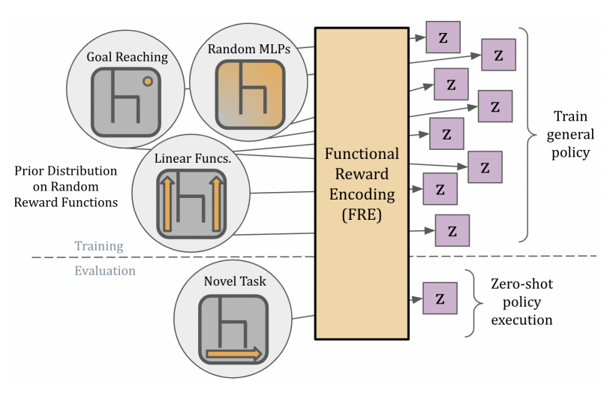
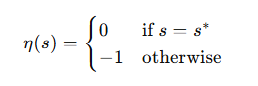
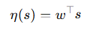
Functional Reward Encoding (FRE)
Random reward functions
Goal Reaching
Linear Functions
Random MLPs
Prior distribution of reward functions
Small sample of unlabeled dataset
(s0, s1, s2….st)
(s0, a0, s1, a0….st)
Z is a compact latent representation that encodes the essential information of a reward function

Slide 5
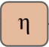

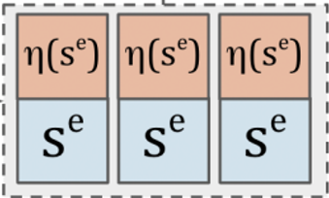
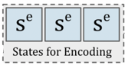
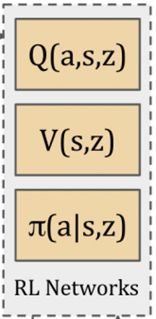
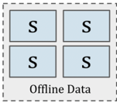
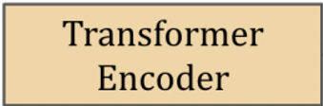
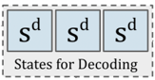
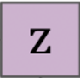
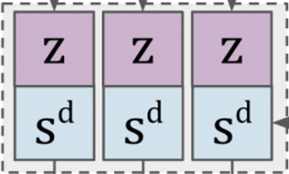
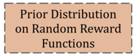
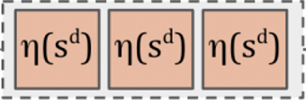
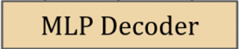
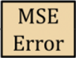
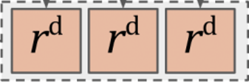
Training - FRE Implementation
Preparation:
Sample a random reward function from the predefined reward distribution
Sample a random reward function from the predefined reward distribution
Encoder:
Assign a reward to each state using the reward function
Convert the rewards into embedding tokens
Combine the reward tokens and states as input to the transformer
Take the average output and use it to compute the mean and standard deviation of a Gaussian distribution over z
Decoder:
Sample new decoder states
Use the learned latent vector z from the encoder
For each state, predict the reward using a feedforward decoder network conditioned on z
Optimization Step:
Compare the predicted reward to the true reward
Jointly train the encoder and decoder to minimize prediction error (MSE)
FRE

Slide 6
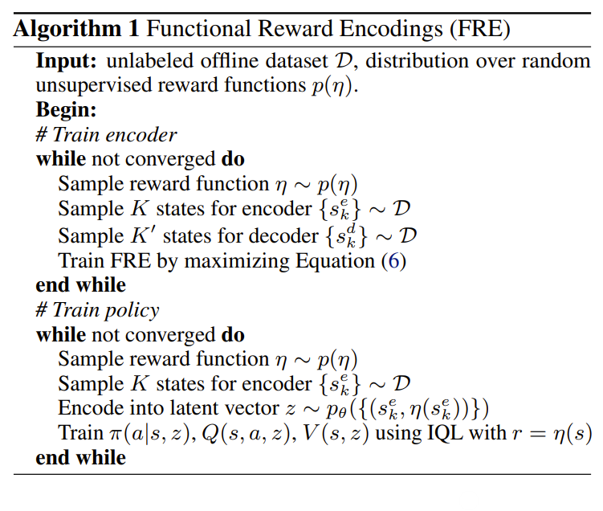
Training - FRE-Conditioned Policy
The encoder is first trained to map reward functions into latent vectors z.
Then, RL components (policy, Q, value) are trained while conditioning on z, using only offline data.
This two-stage training ensures stable and generalizable multi-task learning

Slide 7
Evaluation - Solving New Task (Novel Task)
For a new task with an unknown reward function, we provide a small set of (state, reward) pairs
FRE uses this small set to compute a task-specific latent vector z
The RL networks (policy, value, Q) remain completely unchanged, and can immediately adapt to the new task using the new z vector as input
FRE
S
R
R
R
R
S
S
S
S
R
Small Labeled Dataset

Slide 8
Z Latent representation
Input: K pairs of (s, η(s)) sampled from offline data
Embedding:
Each state s is embedded
Each reward η(s) is converted to a reward token
Concatenation: State and reward embeddings are concatenated and passed into a permutation-invariant Transformer
Mean Pooling: The Transformer outputs are averaged into one summary vector
Distribution Output: • The vector is fed into two MLPs to output μ and σ • Together they define a Gaussian: z ∼ 𝒩(μ, σ²)
Sampling: z is sampled using the reparameterization trick
Average
Mean MLP
Standard Deviation MLP
Z ∼ 𝒩(μ, σ²)
Encoder

Slide 9
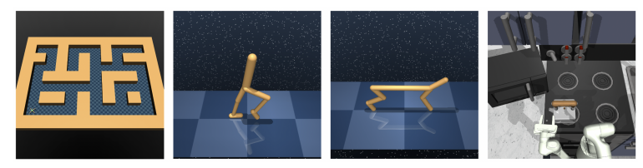
Experimental Benchmarks
FRE was evaluated on three benchmark environments:
ExORL: Cheetah and Walker agents tested on standard tasks like forward/backward motion and goal-reaching
AntMaze: Complex navigation tasks including goal-reaching, directional movement, random rewards, and custom paths
Kitchen: Robotic hand performing 7 daily tasks, tested in a multi-task setup with sparse reward signals

Slide 10
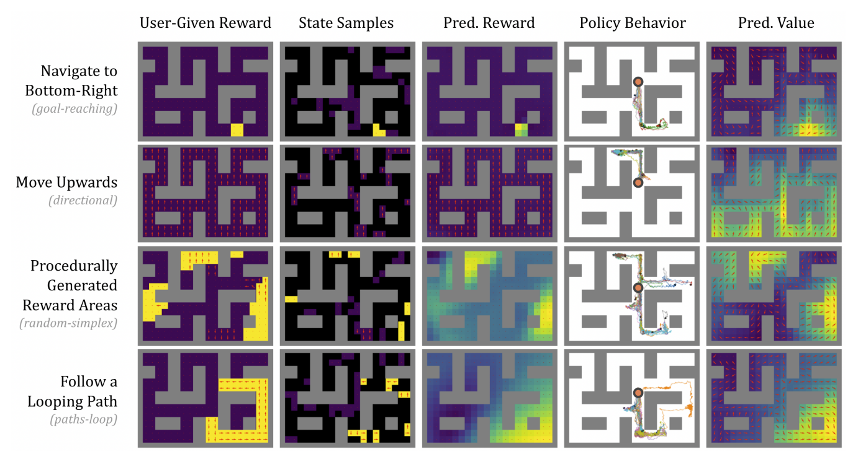
Zero-Shot Generalization Test
FRE successfully generalizes to unseen tasks without further training.
The learned value function accurately reflects expected returns, and the policy generally performs well.

Slide 11
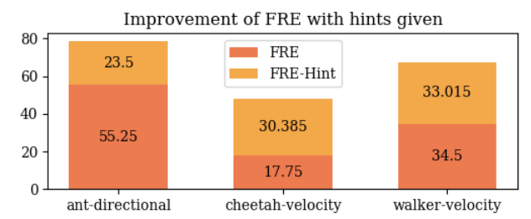
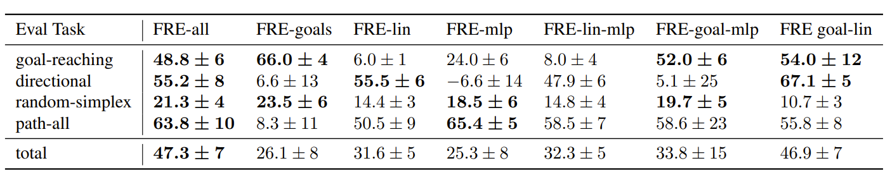
FRE Scalability & Prior Knowledge
FRE can leverage known task structures to improve encoding accuracy, without changing the architecture or requiring task labels
Training on more reward types improves performance, showing FRE's strong generalization and scalability.

Slide 12
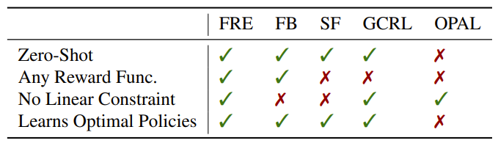
Comparison Methods for Zero-Shot Offline RL
Compare* FRE to prior state-of-the-art approaches:
FRE – Learns latent reward representations to generalize across tasks without retraining
FB (Forward-Backward) – Jointly learns task and policy representations using successor feature
SF (Successor Features) – Approximates rewards and policies via fixed feature representations
GC-IQL – Goal-conditioned policy using Implicit Q-Learning and hindsight relabeling
GC-BC – Behavioral cloning approach based on successful goal-reaching trajectories
OPAL – Unsupervised skill learning via trajectory auto-encoding from offline data
* All methods were evaluated under the same conditions, using five random seeds and 20 evaluation episodes. FRE, GC-IQL, and GC-BC share architecture and codebase, while FB and SF use DDPG-based policies, and OPAL was re-implemented for consistency.

Slide 13
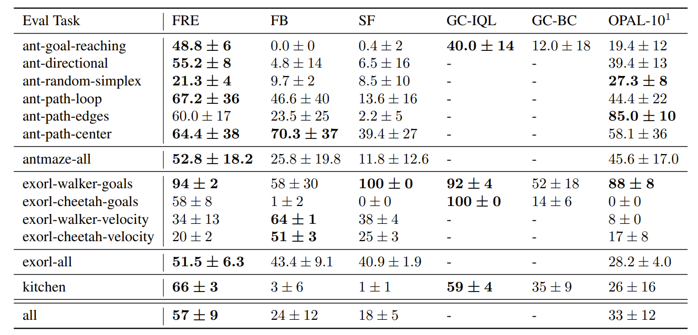
FRE vs. Baselines

Slide 14

Conclusions
Introduced the first method for Zero-Shot Offline RL that requires no fine-tuning on new tasks
FRE learns a universal latent space for reward functions
Advance the development of generalist unsupervised agents with strong task generalization abilities

Slide 15

Limitations
Relies on a hand-specified prior reward distribution
Optimal reward priors still unclear
Currently limited to offline data
Enhance FRE by adding task descriptions to the encoder input, enabling better generalization from limited (s, r) samples.

Slide 16

Q&A

